Slide 1
Detection of Anomaly in SAR Images
Love Sachdeva 19BCE1739
Abhishek Yadav 19BCE1308
Deb Shankar Mondal

Slide 2
Problem Statement:
The stated problem deals with the issues associated with the Synthetic Aperture Radar (SAR) imagery. SAR images, besides of having great applications like performing acquisition of visual information in typical constraints viz. weather and illumination, SAR images are encompassed with disturbing noises and other anomalies which deviate from standard or expected results. Theses anomalies must be detected to minimize the discrepancies.

Slide 3
Scope:
Anomaly detection is applied to detect and sign the ground pixels which are different from the clutter background based on the pattern recognition and the statistical methods. Keeping in view the same, anomaly detection in SAR images with high accuracy rate and low processing time can be proved extremely applicable and serviceable.
The proposed project will perform efficiently and effectively in extracting information from even low- resolution images.

Slide 4
Software and Hardware requirements
OpenCV library which provides real-time computer vision and machine learning software library.
Tensor flow used to train cnn model on gpu
Keras is used for object detection
PIL is used for image transformation
H5py is used for saving and running CNN Models
Retinanet 50 is used for object detection.

Slide 5
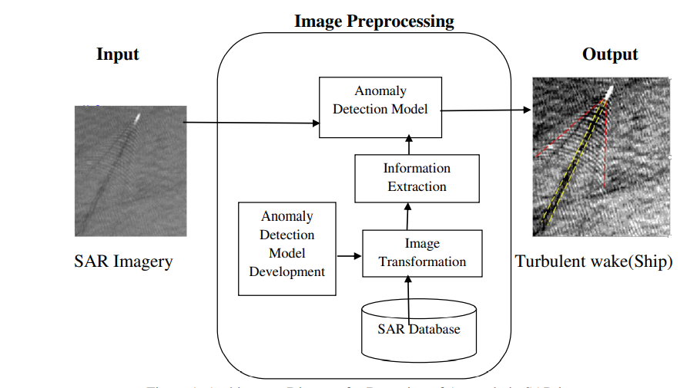
Methodology:

Slide 6
Methodology (cont.):
Above architecture diagram incorporates 4 steps which show the how this project will be processed which are collection of SAR images from various satellite sources, images transformation using available data augmentation techniques then information or feature extraction of processed images and then train and develop the CNN based anomaly detection model

Slide 7
Dataset:
The solution depends on the datasets obtained from data recorded by geostationary satellites and Indian Weather Satellites.

Slide 8
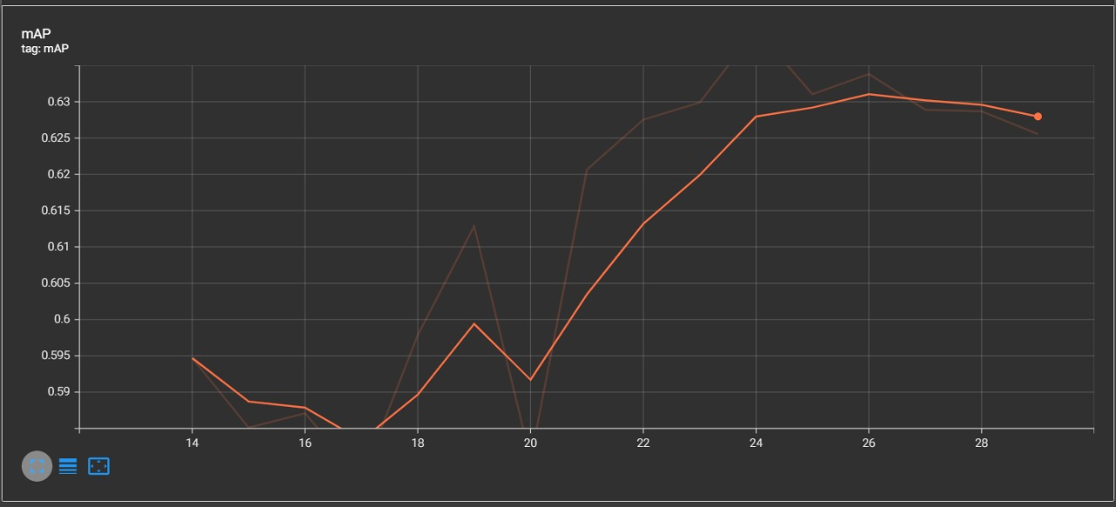
Evaluation measures:
evaluation measures such as size, distance, angle, orientation of anomaly or outlier can be detected with respect to the object and Mean Average Precision(MAP) and accuracy will be computed by comparing the detected anomalies in SAR images and ground truth images of satellites.

Slide 9
Result:
This project deals with the detection of anomalies such as aircrafts, unmanned Aerial vehicle (UAV) or drones in SAR images. These anomalies can be related to threats at airports, under water vehicles such as submarines etc. For further evaluation SAR images of objects can be taken at different angles at different time.

